Slide 1
Customer Churn Prediction
Hillidatul Ilmi

Slide 2

TABLE OF CONTENTS
1
About Customer Churn
2
Dataset Information
3
Best Parameter Model
Customer churn
Prediction
4

Slide 3
01.
Customer Churn

Slide 4
What is Churn ?
accounts that cancel or choose not to renew their subscriptions.
Customer !!!
The rate at which customers stop doing business with an entity.

Slide 5
02.
Dataset Information

Slide 6
Telco Customer !!! Churn Target
1.
Total
Charges
2.
Tenure
3.
Monthly
Charges
4.
Contract
5.
Online
Security
6.
Tech
Support
12.
Partner
11.
Paperless
Billing
10.
Dependents
9.
Senior
Citizen
8.
Device
Protection
7.
Online
Backup

Slide 7

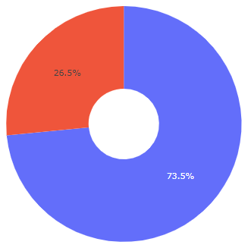
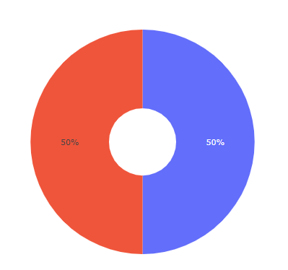

Exploratory Data Analysis
Data Imbalance

Slide 8
03
Best Parameter Model

Slide 9
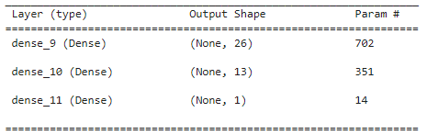
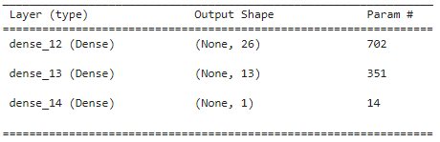
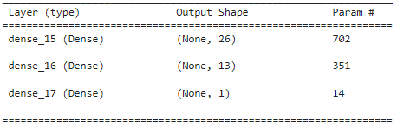
Model Definition & Training
Model Definition 1
First layer with 26 neurons, second layer with 13 neurons with 'relu'. In the last layer 1 neuron with 'sigmoid'. Optimizer is 'adam' , Loss is 'binary_crossentropy' while the evaluation matrix uses ‘accuracy’.
Model Definition 2
First layer with 26 neurons, second layer with 13 neurons with ‘elu'. In the last layer 1 neuron with 'sigmoid'. Optimizer is 'adam' , Loss is 'binary_crossentropy' while the evaluation matrix uses ‘accuracy’.
Model Definition 3
First layer with 26 neurons, second layer with 13 neurons with ‘selu'. In the last layer 1 neuron with 'sigmoid'. Optimizer is 'adam' , Loss is 'binary_crossentropy' while the evaluation matrix uses ‘accuracy’.

Slide 10
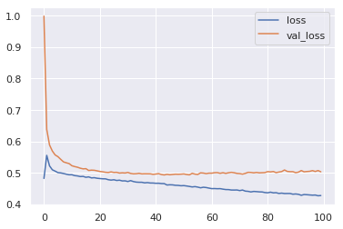
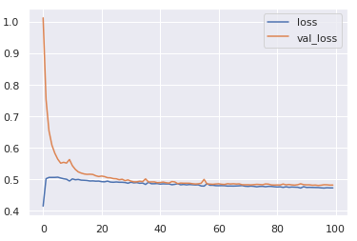
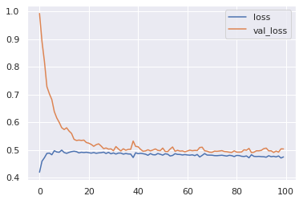
Model Evaluation
Activation layer is Relu and activation output is sigmoid
Activation layer is Elu and activation output is sigmoid
Activation layer is Selu and activation output is sigmoid
Best Parameter

Slide 11
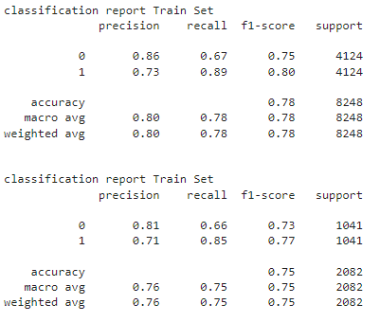
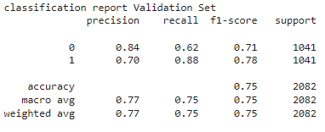
classification report
Recall 0 from the comparison of companies losing customers who have not used the services/products of the company Solar System
Recall 1 from the comparison of companies getting customers who continue to use the services/products of the company

Slide 12
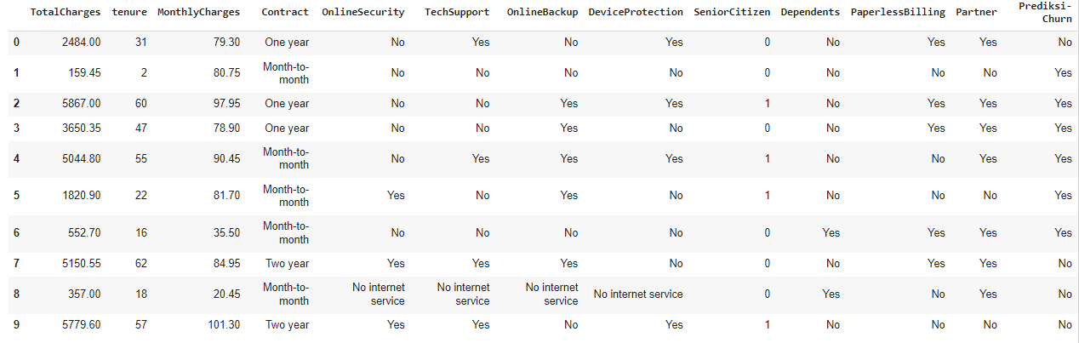
Model Inference

Slide 13
04
Customer churn Prediction

Slide 14
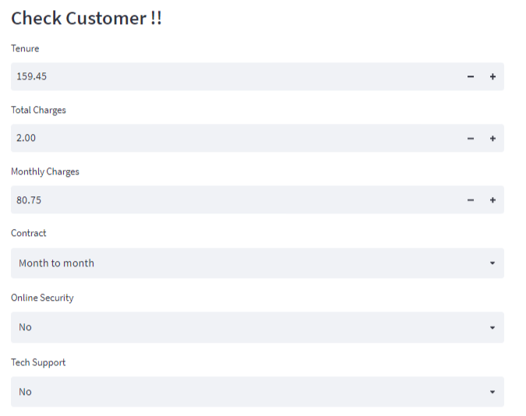
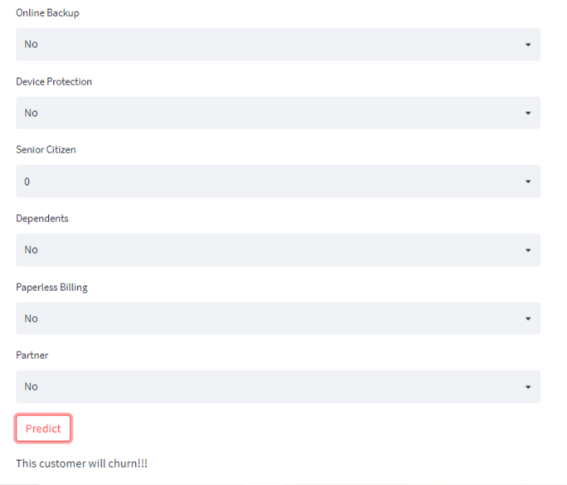
Customer Will Churn

Slide 15
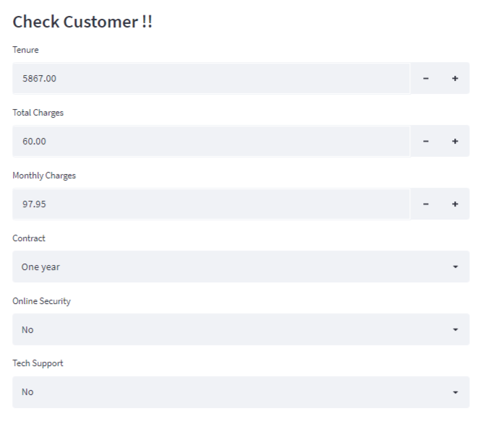
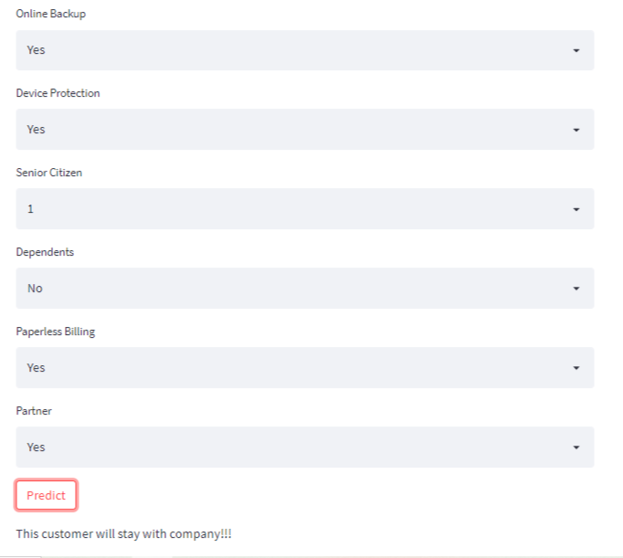
Customer Stay Churn

Slide 16
Conclusion
The best model parameter is to make the first layer 26 neurons add a second layer with 13 neurons activating the 'elu' layer, then the last layer is the classification activati sigmoid function. Optimizer uses adam, Loss uses 'binary_crossentropy' because the expected output is binary (churn yes or no)
The accuracy value of the best parameter model in the training set is 78% and the validation set is 75%.
This can be a consideration for service provider companies to further improve performance, so that customers can continue to continue to use services. Or you can provide a variety of services so that customers like it

Slide 17
Thanks!!

